Slide 1
Best Downtown Chicago Fast Food Location

Slide 2
What is the best location?
Downtown Chicago has hundreds of thousands of commuters daily
Commuters use both CTA (to move through the city) and Metra (from suburbs)
Being near more mass transit lines it good for business
Being near more businesses is good for lunch crowd business
Being near other food options can be good for business too
Normally having too many fast food places nearby would hurt business, but the volume of customers is very high. This means that the foot traffic for the competition is itself advertisement and if it takes too long to get food elsewhere, it will bring people into your spot.

Slide 3
Data
All data was obtained from the foursquare API
CTA trains, CTA busses and fast food locations were pulled and formated into separate data frames
Start points were 500 W Madison (Ogilvie and Union Metra Stations) and 50 E Madison (Central downtown Chicago) and data was cleaned and combined

Slide 4
Process
Predicting the best place to put a new fast food place would be dependent on the density of the three factors with heaviest weight on trains and lowest on other fast food places.
Using clustering, we find that all three are near the same block.

Slide 5
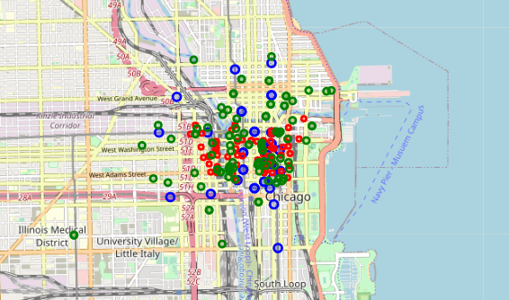
Raw data mapped
Blue: Train Stops
Red: Bus Stops
Green: Fast Food

Slide 6
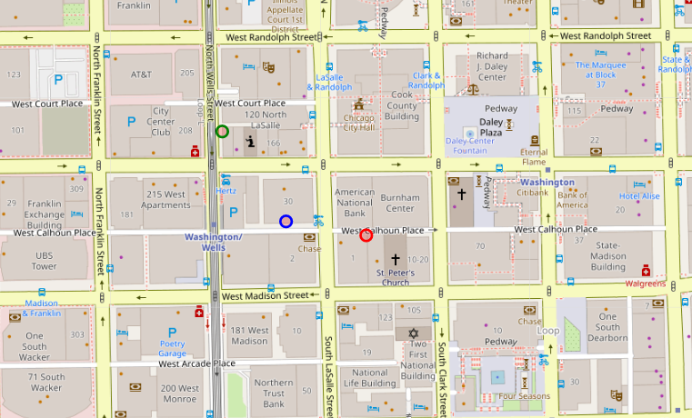
Final Locations
With the weighing and the final output, we see that the train data, bus data and fast food data all center around Lasalle and Washington streets.

Slide 7
Conclusion
With just the location data from foursquare we can see the highest foot traffic areas in downtown Chicago and prime locations to build a new fast food place.
This model can be improved using data from CTA and Metra to further weigh the different stops and lines based on traffic through each of them at different times of day.

